Slide 1
What Is Machine Learning?

Slide 2
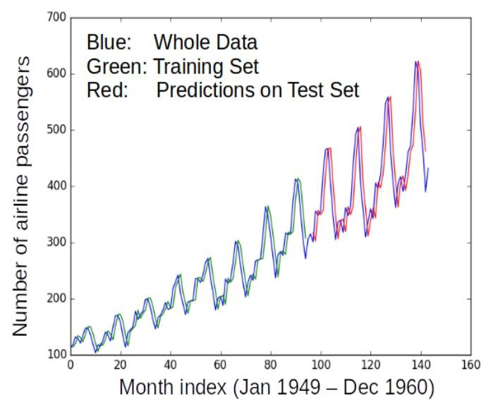
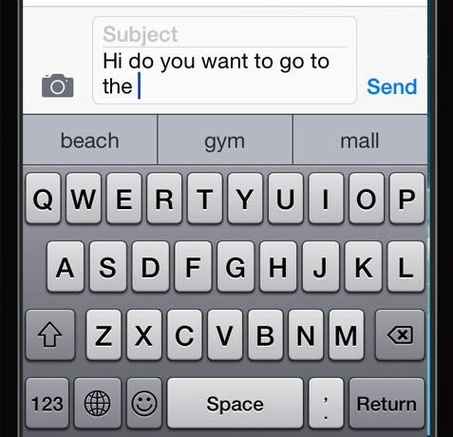
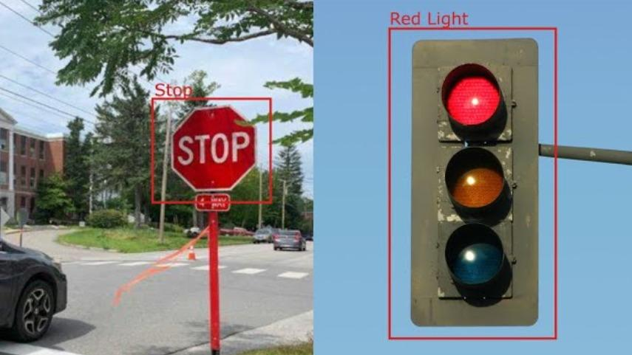
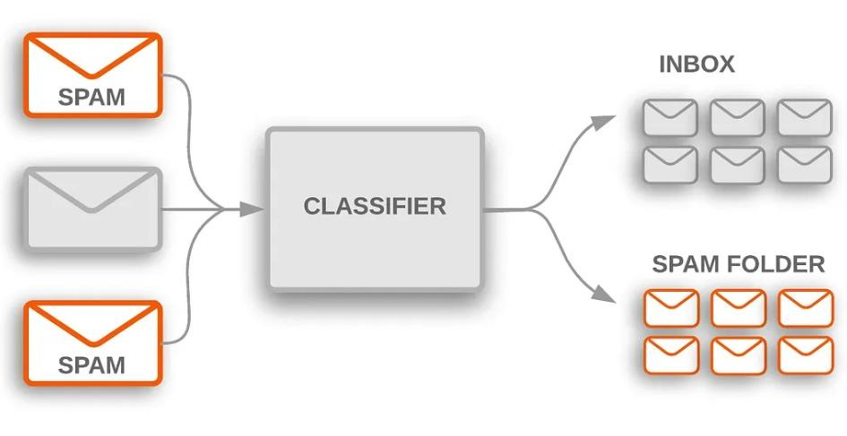
Machine Learning (ML)
Designing algorithms that ingest data and learn a model of the data
The learned model can be used to
Detect patterns/structures/themes/trends etc. in the data
Make predictions about future data and make decisions
Modern ML algorithms are heavily “data-driven”
No need to pre-define all the rules by humans (infeasible/impossible anyway)
The rules are not “static”; can adapt as the ML algo ingests more and more data
Next word prediction (key task in large-language models like ChatGPT)

Slide 3
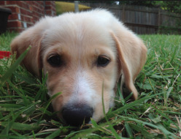
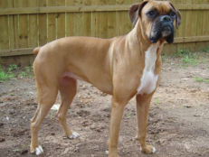
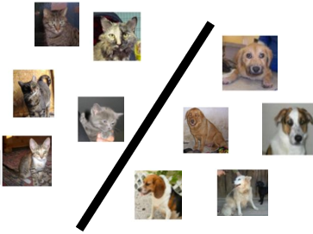
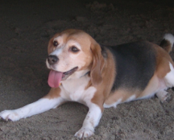
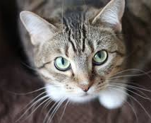


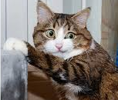

Supervised Learning
Labeled
Training
Data
“dog”
Supervised Learning
Algorithm
“dog”
“cat”
“cat”
Cat vs Dog
Prediction model
“cat”
Important: In ML (not just sup. learning but also unsup. and RL), training and test datasets should be “similar” )
Predicted Label
(cat/dog)
A test image
In the above example, it means that we can’t have test data with BnW images or sketches of cats and dogs
Cat vs Dog
Prediction model

Slide 4
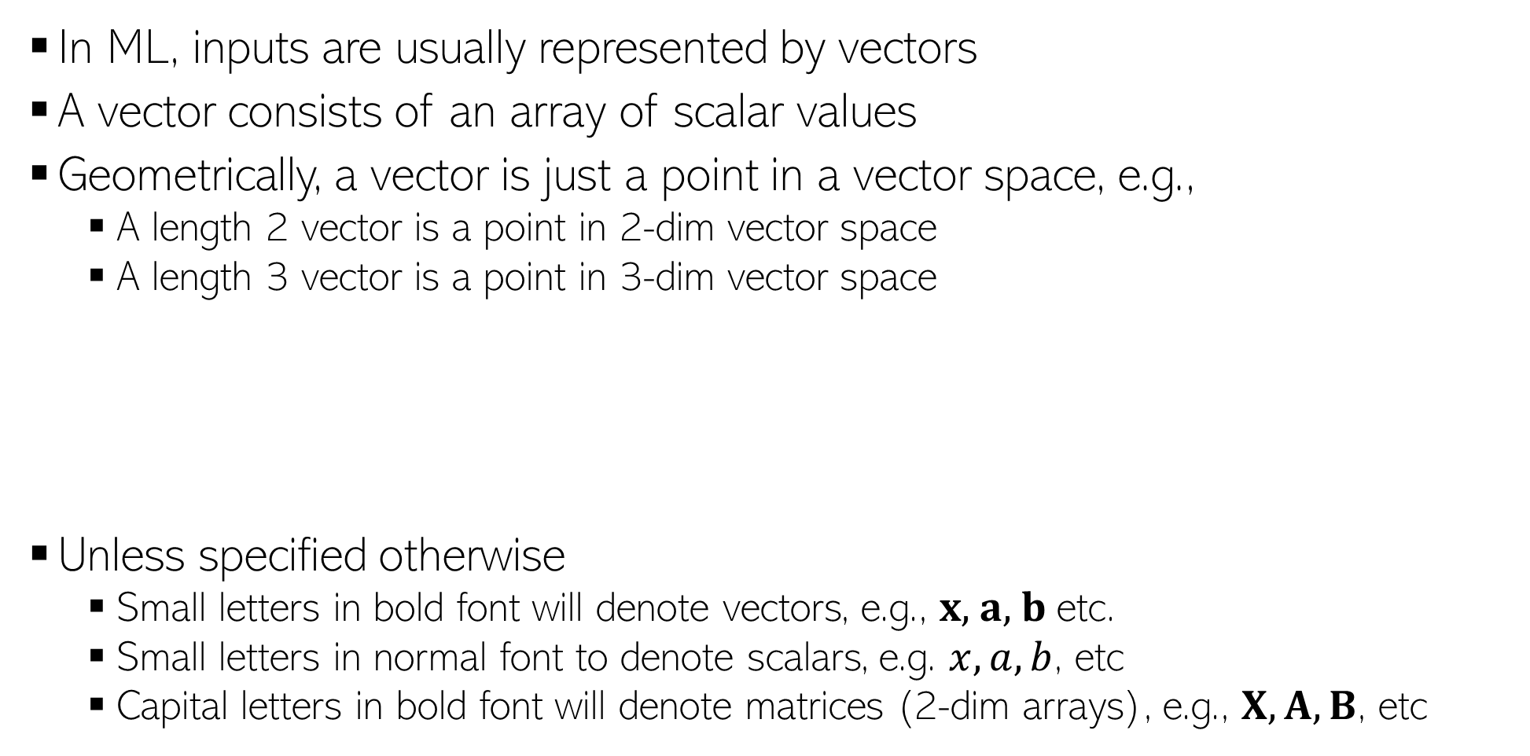
Some Notation and Conventions
0.5 | 0.3 | 0.6 | 0.1 | 0.2 | 0.5 | 0.9 | 0.2 | 0.1 | 0.5
Likewise for higher dimensions, even though harder to visualize
(0.5,0.3)
(0.5,0.3,0.6)
0.5 | 0.3 | 0.6
0.5 | 0.3

Slide 5
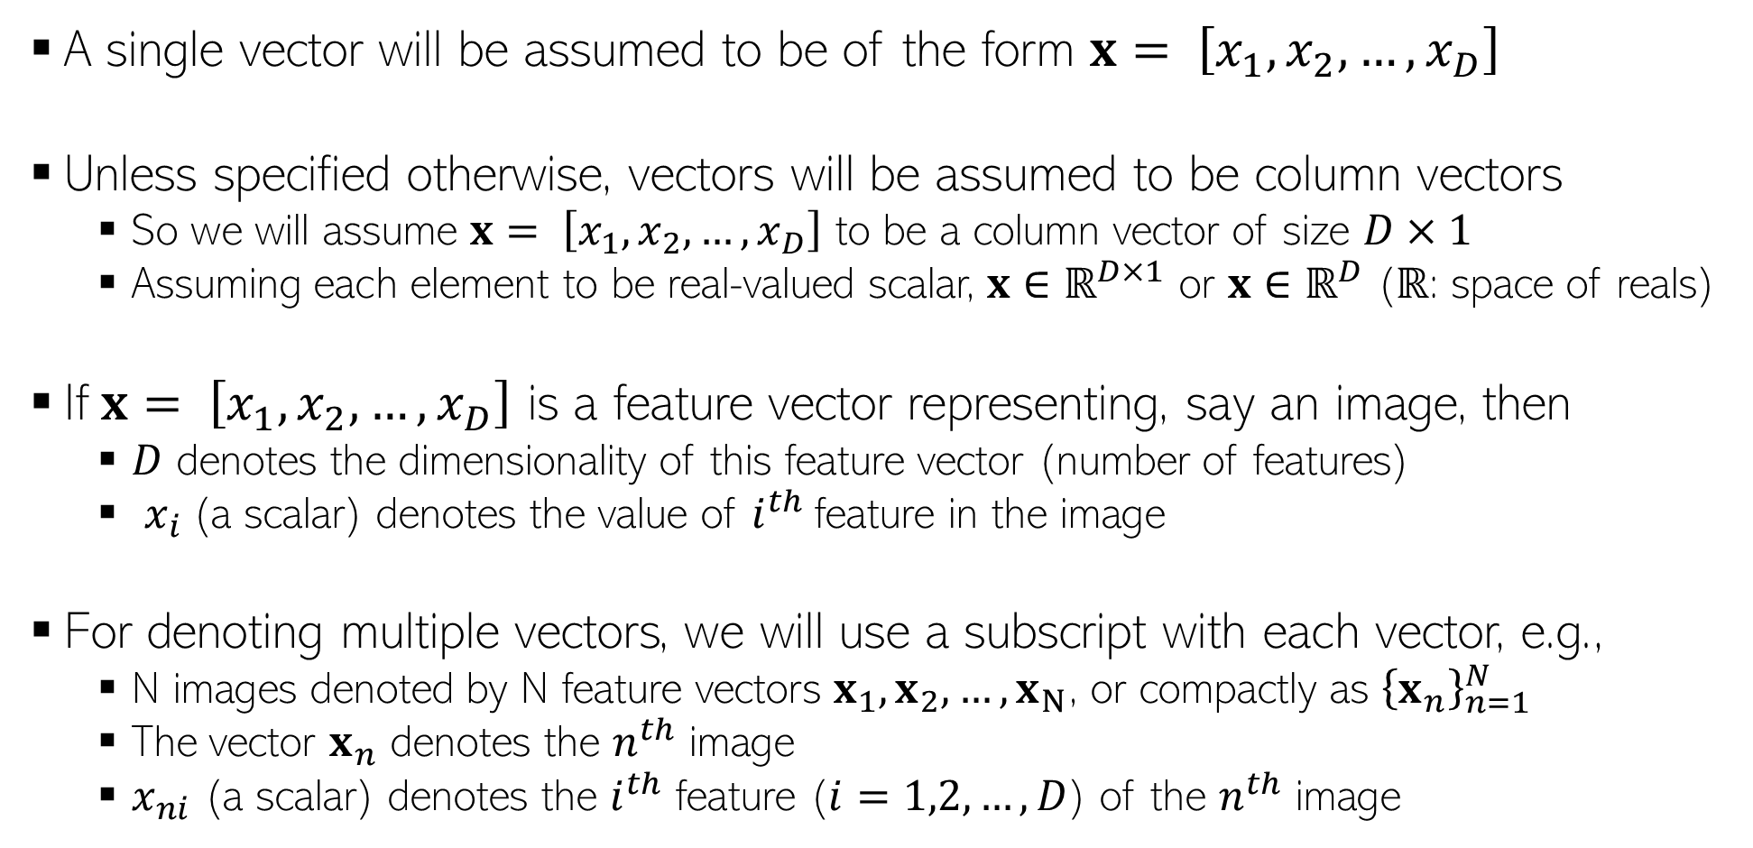
Some Notation and Conventions

Slide 6
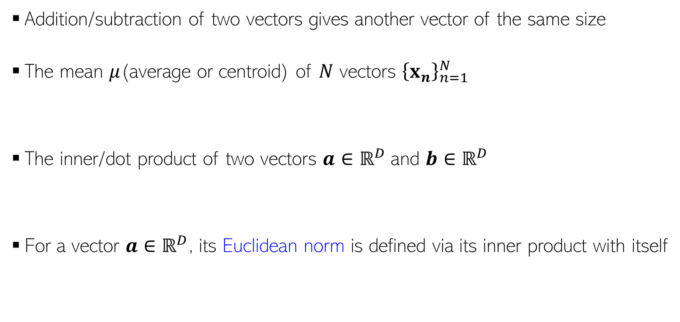
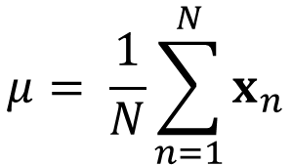
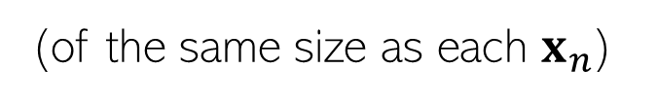
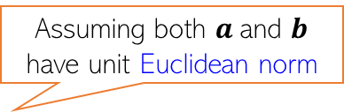
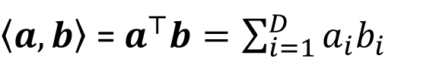
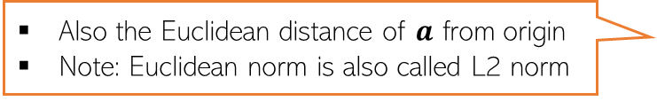
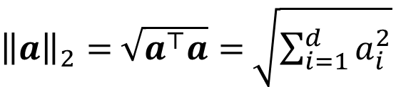
Some Basic Operations on Vectors

Slide 7
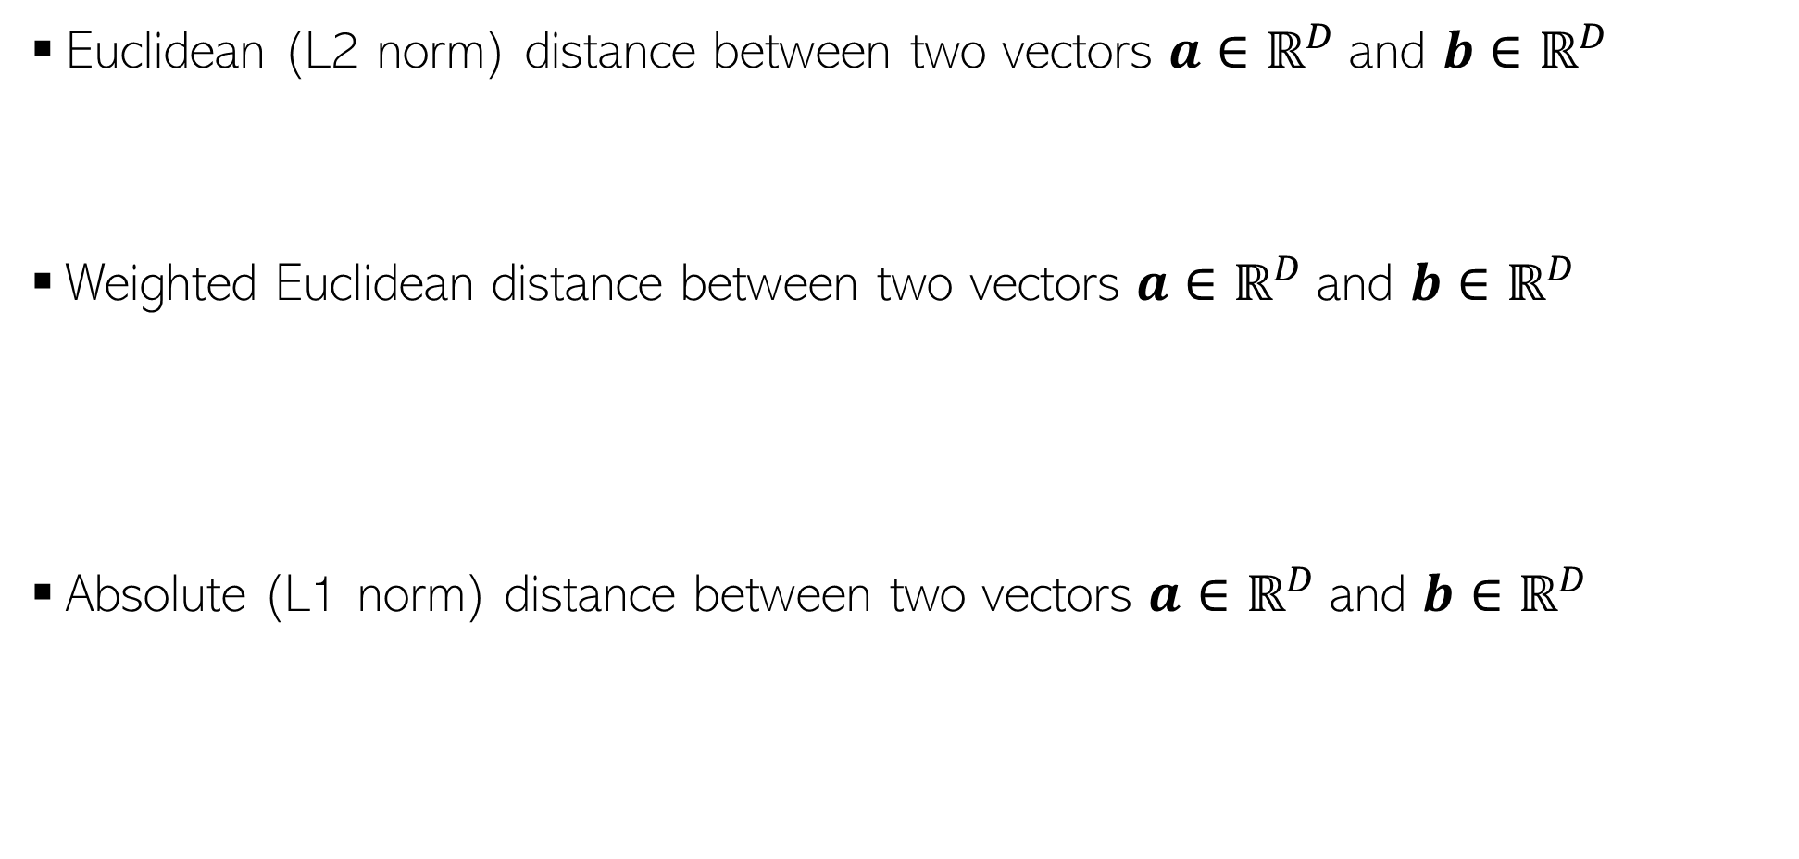
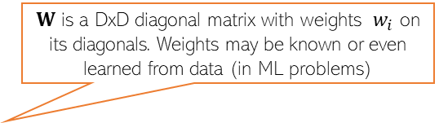
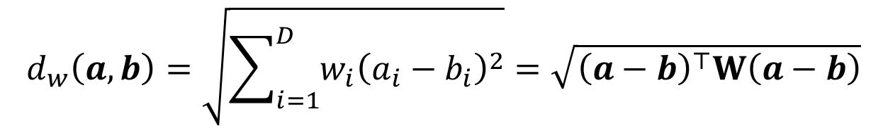
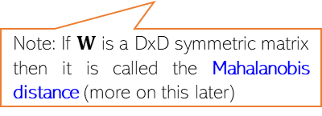
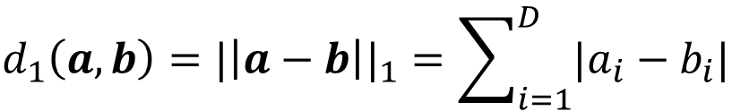
Computing Distances
Sqrt of Inner product of the difference vector!
Another expression in terms of inner products of individual vectors
Useful tip: Can achieve the effect of feature scaling by using weighted Euclidean distances!

Slide 8
Nearest Neighbors

Slide 9

Nearest Neighbors
Wait. Did you say distances from ALL the training points? That’s gonna be sooooo expensive! ☹
Very simple idea. Simply do the following at test time
Compute distances of the test point from all the training inputs
Sort the distances to find the “nearest” input(s) in training data
Predict the label using majority or avg label of these inputs
Note: Can work with similarities as well instead of distances
Can use Euclidean or other dist (e.g., Mahalanobis). Choice imp just like LwP
Unlike LwP which does prototype based comparison, nearest neighbors method looks at the labels of individual training inputs to make prediction
Applicable to both classifn as well as regression (LwP only works for classifn)
Yes, but let’s not worry about that at the moment. There are ways to speed up this step

Slide 10
Nearest Neighbors for Classification

Slide 11
Nearest Neighbor (or “One” Nearest Neighbor)
Decision boundary
Nearest neighbour approach induces a partition of the input space (all test points falling in a cell will get the label of the training input in that cell)
Test point
Test point

Slide 12
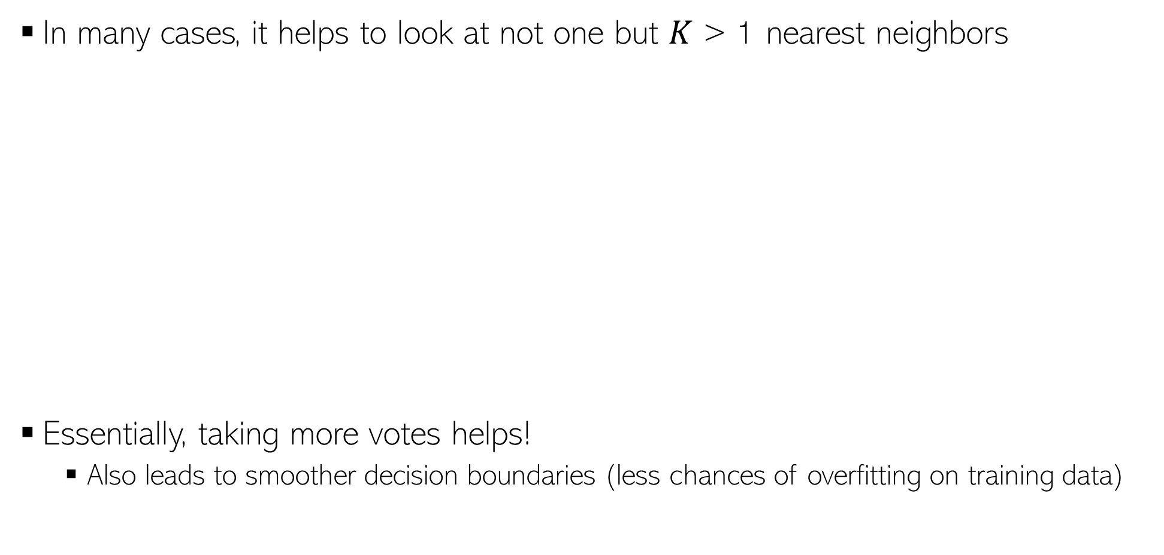


K Nearest Neighbors (KNN)
Test input
How to pick the “right” K value?
K is this model’s “hyperparameter”. One way to choose it is using “cross-validation” (will see shortly)
Also, K should ideally be an odd number to avoid ties

Slide 13







Weighted KNN
The standard KNN treat all nearest neighbors equally (all vote equally)
An improvement: When voting, give more importance to closer training inputs
Test input
+
+
=
In weighted approach, a single red training input is being given 3 times more importance than the other two green inputs since it is sort of “three times” closer to the test input than the other two green inputs
Unweighted KNN prediction:
+
+
=
Weighted KNN prediction:

Slide 14
Linear Models and Learning via Optimization
‹#›

Slide 15
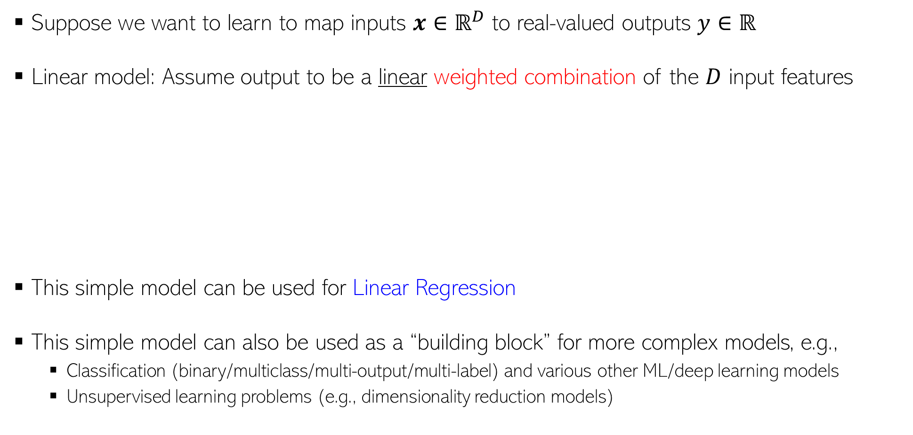
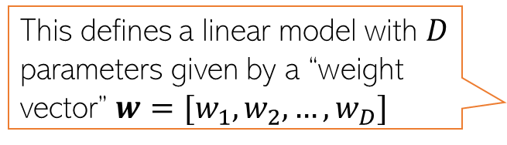
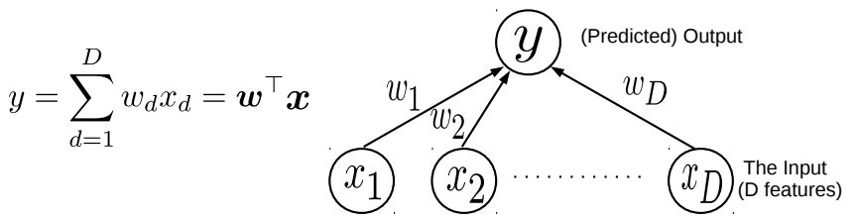
Linear Models
‹#›
The “optimal” weights are unknown and have to be learned by solving an optimization problem, using some training data

Slide 16
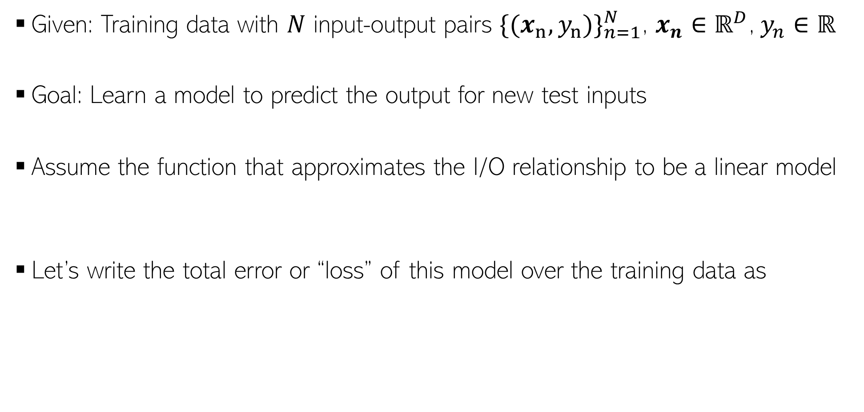
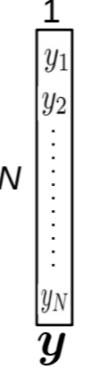
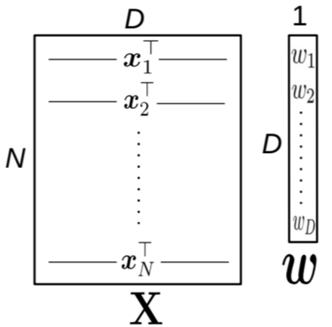
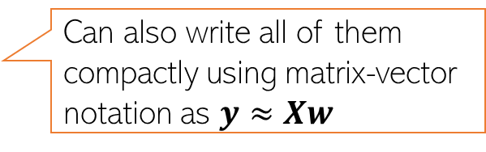
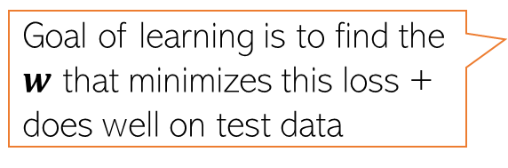
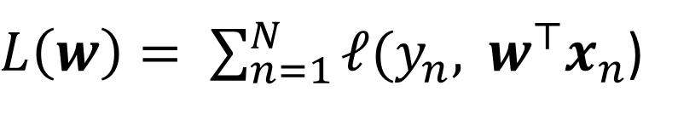
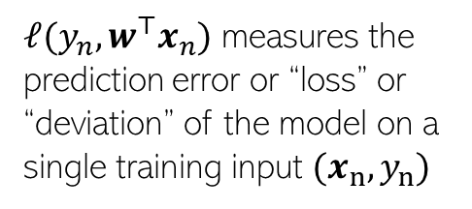
Linear Regression
‹#›

Slide 17


Linear Regression: Pictorially
‹#›
Linear regression is like fitting a line or (hyper)plane to a set of points
The line/plane must also predict outputs of the unseen (test) inputs well
What if a line/plane doesn’t model the input-output relationship very well, e.g., if their relationship is better modeled by a nonlinear curve or curved surface?

Slide 18





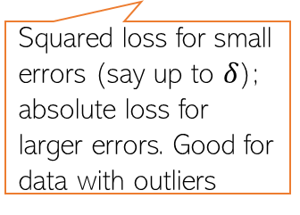
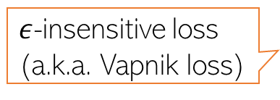






Loss Functions for Regression
‹#›
Many possible loss functions for regression problems
Squared loss
Loss
Absolute loss
Loss
Loss
Huber loss
Loss
Note: Can also use squared loss instead of absolute loss

Slide 19
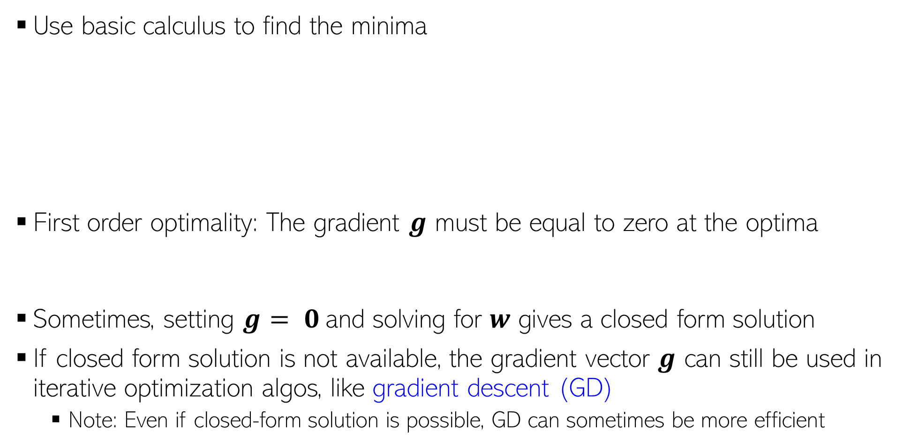
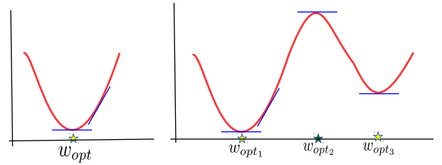
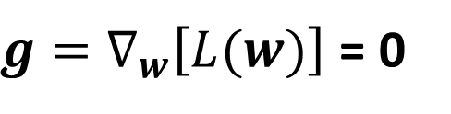
Minimizing Loss Func using First-Order Optimality

Slide 20
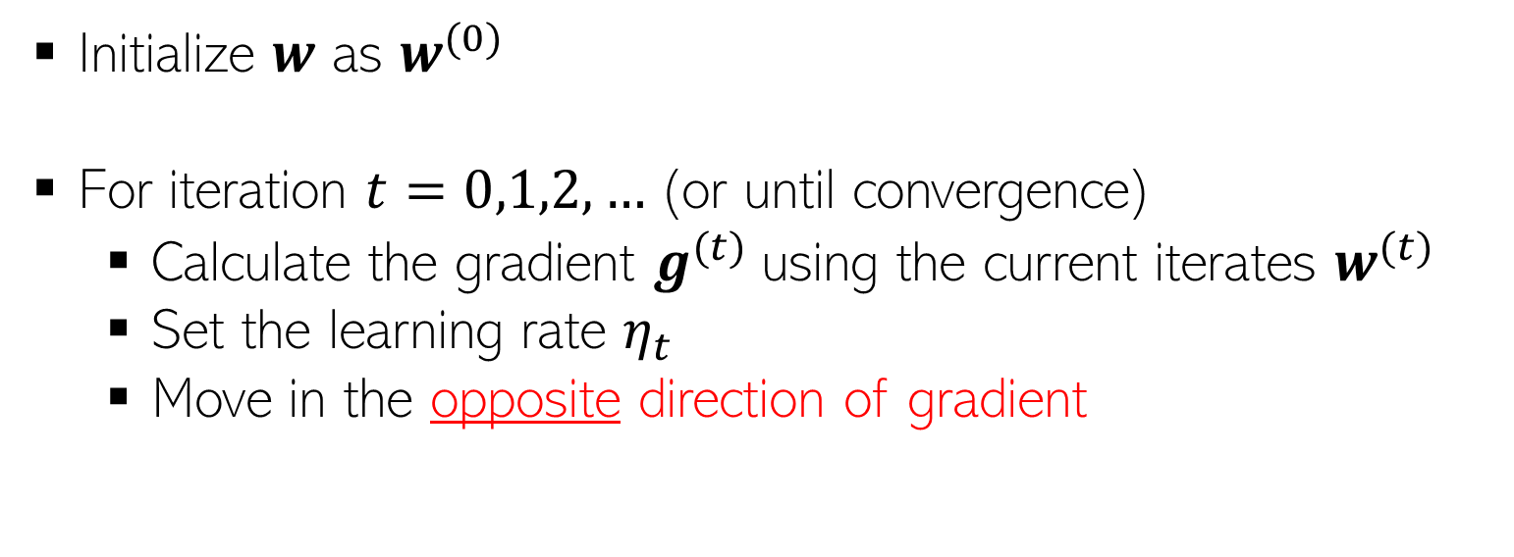

Minimizing Loss Func. using Iterative Optimization
Iterative since it requires several steps/iterations to find the optimal solution
Fact: Gradient gives the direction of steepest change in function’s value
Gradient Descent
The learning rate very imp. Should be set carefully (fixed or chosen adaptively).

Slide 21
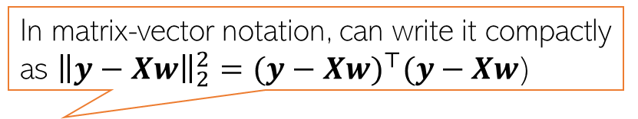
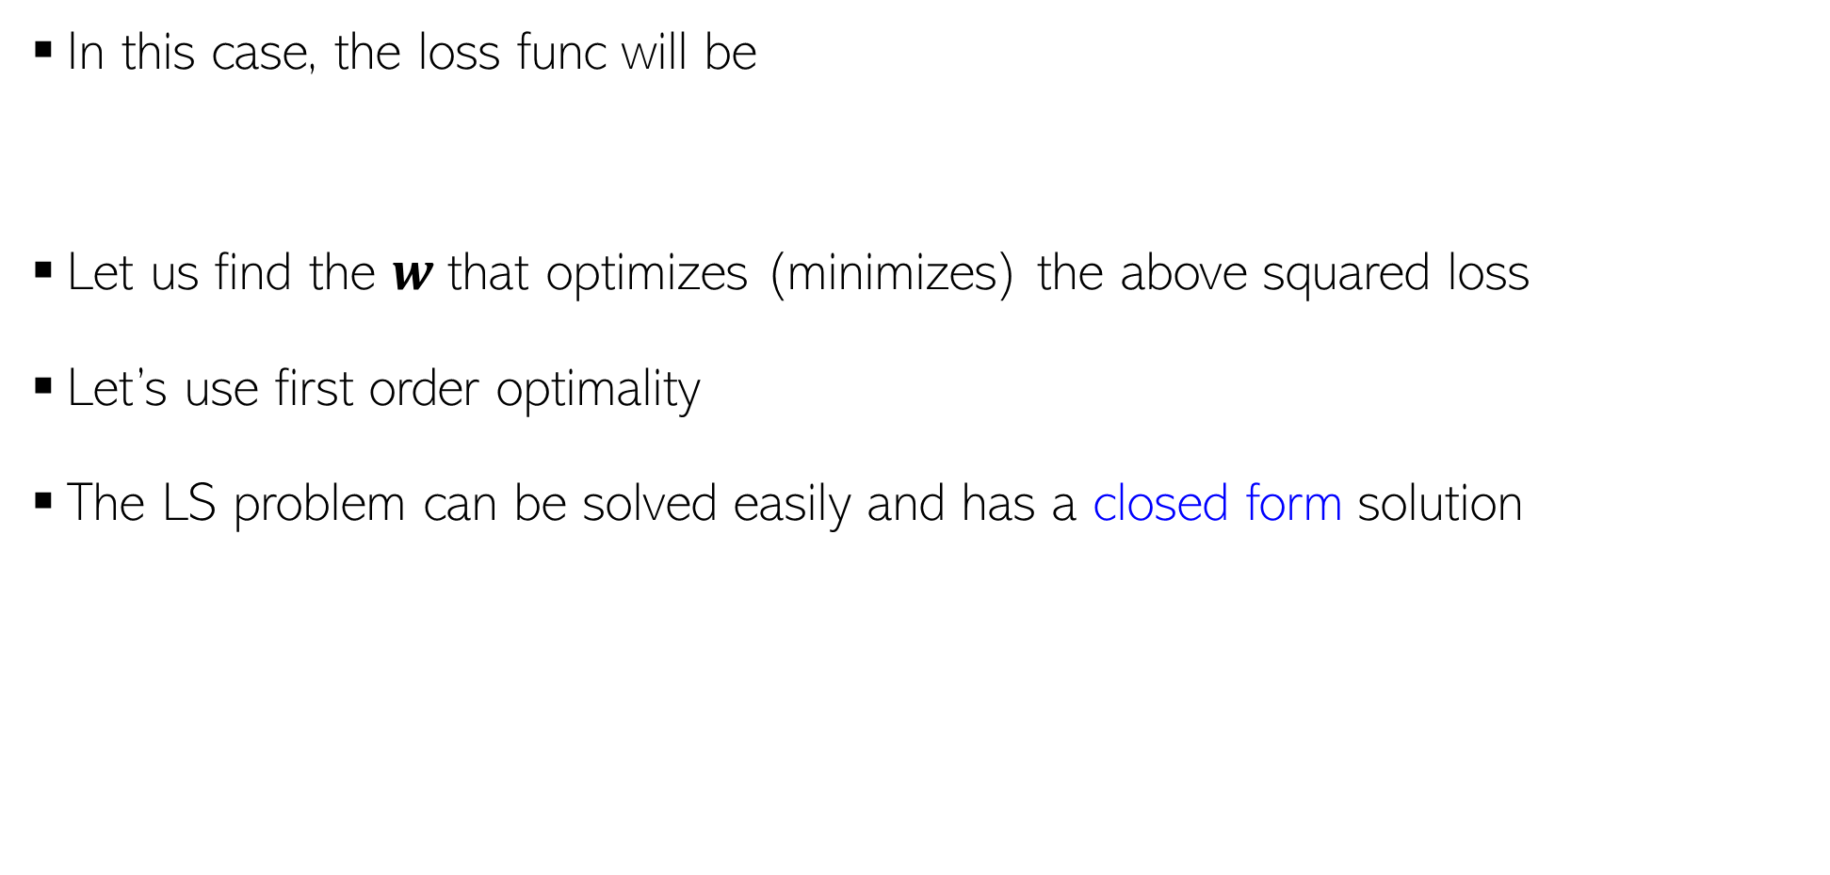

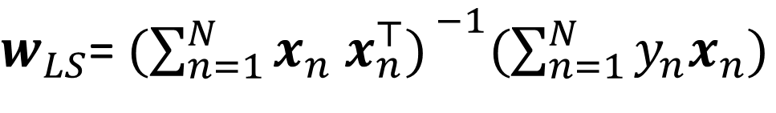

Linear Regression with Squared Loss
‹#›
Closed form solutions to ML problems are rare.

Slide 22
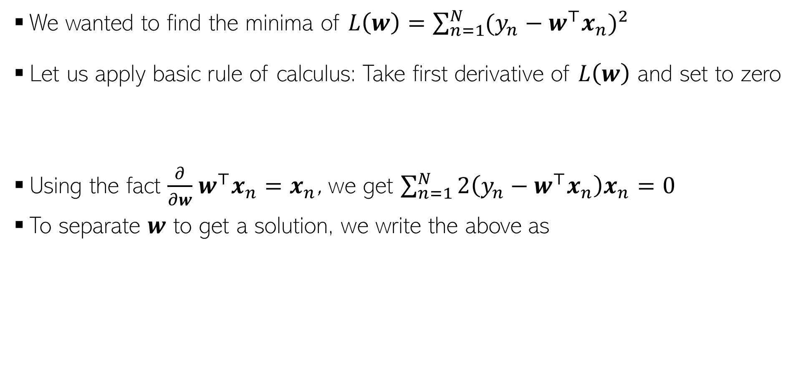

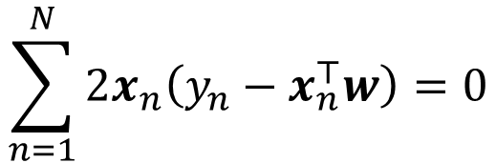
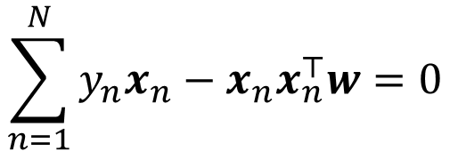
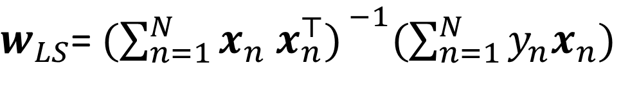

Proof: A bit of calculus/optim. (more on this later)
‹#›
Chain rule of calculus

Slide 23
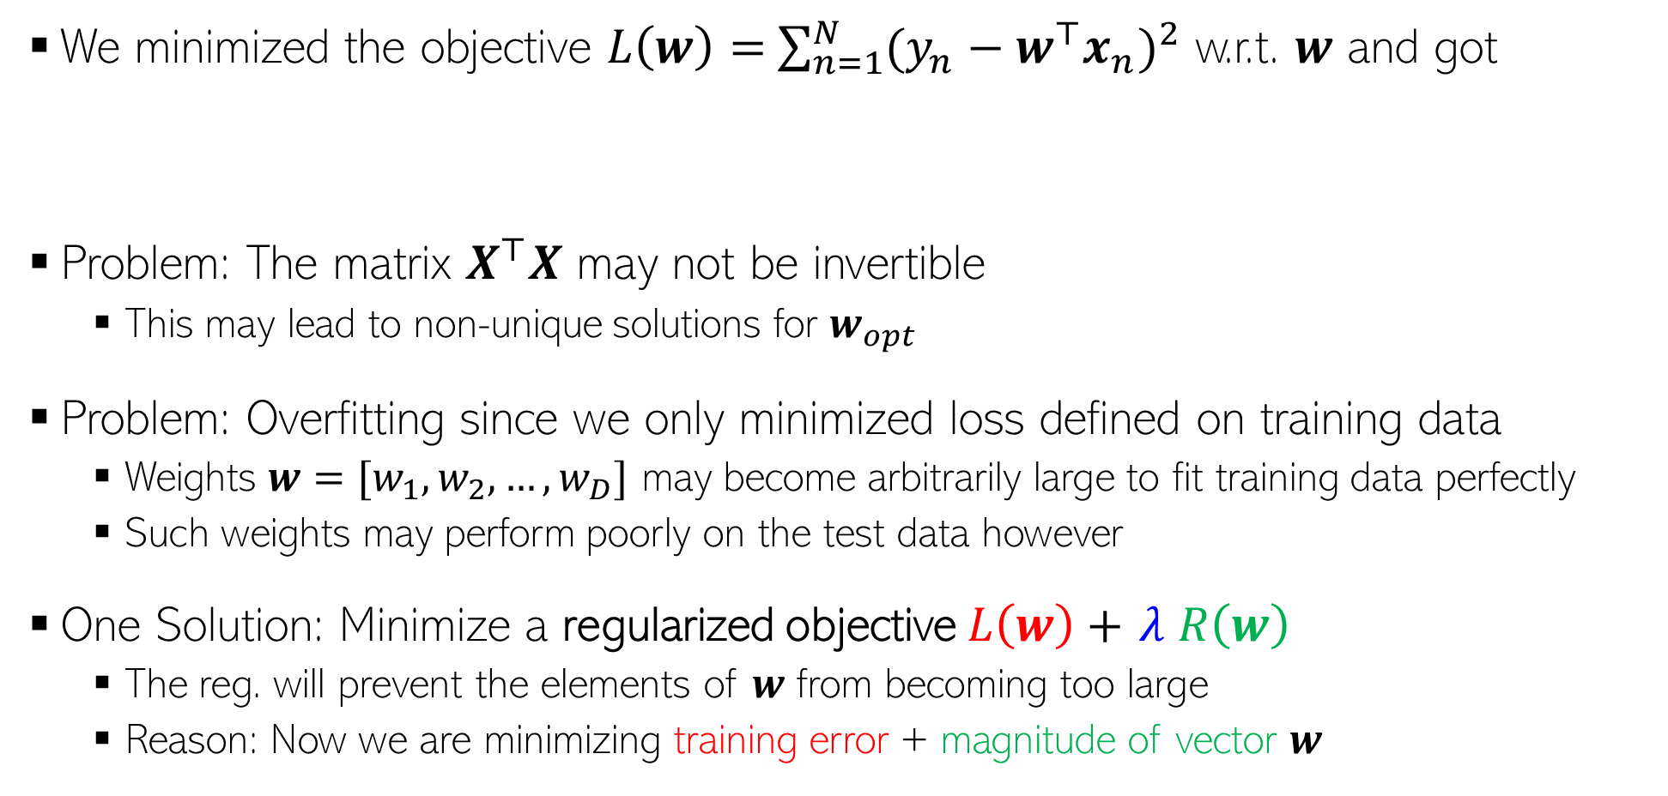
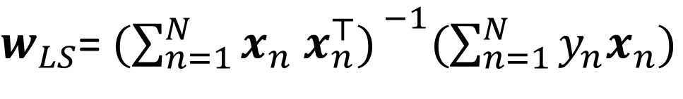


Problem(s) with the Solution!
‹#›

Slide 24







Regularized Least Squares (a.k.a. Ridge Regression)
Why is the method called “ridge” regression

Slide 25
Linear Models for Classification
‹#›

Slide 26








Linear Models for Classification
‹#›
Large positive score means positive label, otherwise negative label
1
The “sigmoid” function
Popularly known as “logistic regression” (LR) model (misnomer: it is not a regression model but a classification model), a probabilistic model for binary classification
Squashes a real number to the range 0-1
0.5
0

Slide 27





Linear Models: The Decision Boundary

Slide 28


Loss Functions for Classification
‹#›

Slide 29






Loss Functions for Classification: Cross-Entropy
‹#›
This is precisely what we want from a good loss function for binary classification

Slide 30




Cross-Entropy Loss: The Gradient
‹#›
The expression for the gradient of binary cross-entropy loss

